Slide 1
ssǝɔoɹd ǝɥʇ ǝƃuǝllɐɥɔ
WE NEED to
Everything is a remix:
CREATIVITY & INNOVATION

Slide 2
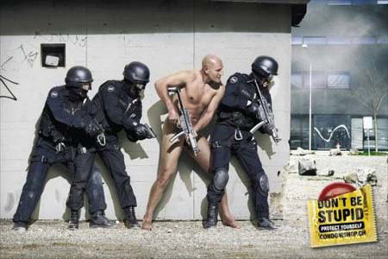

Slide 3
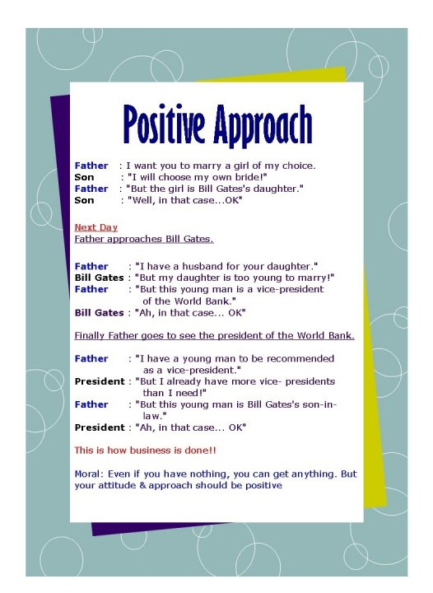

Slide 4


Slide 5


Slide 6
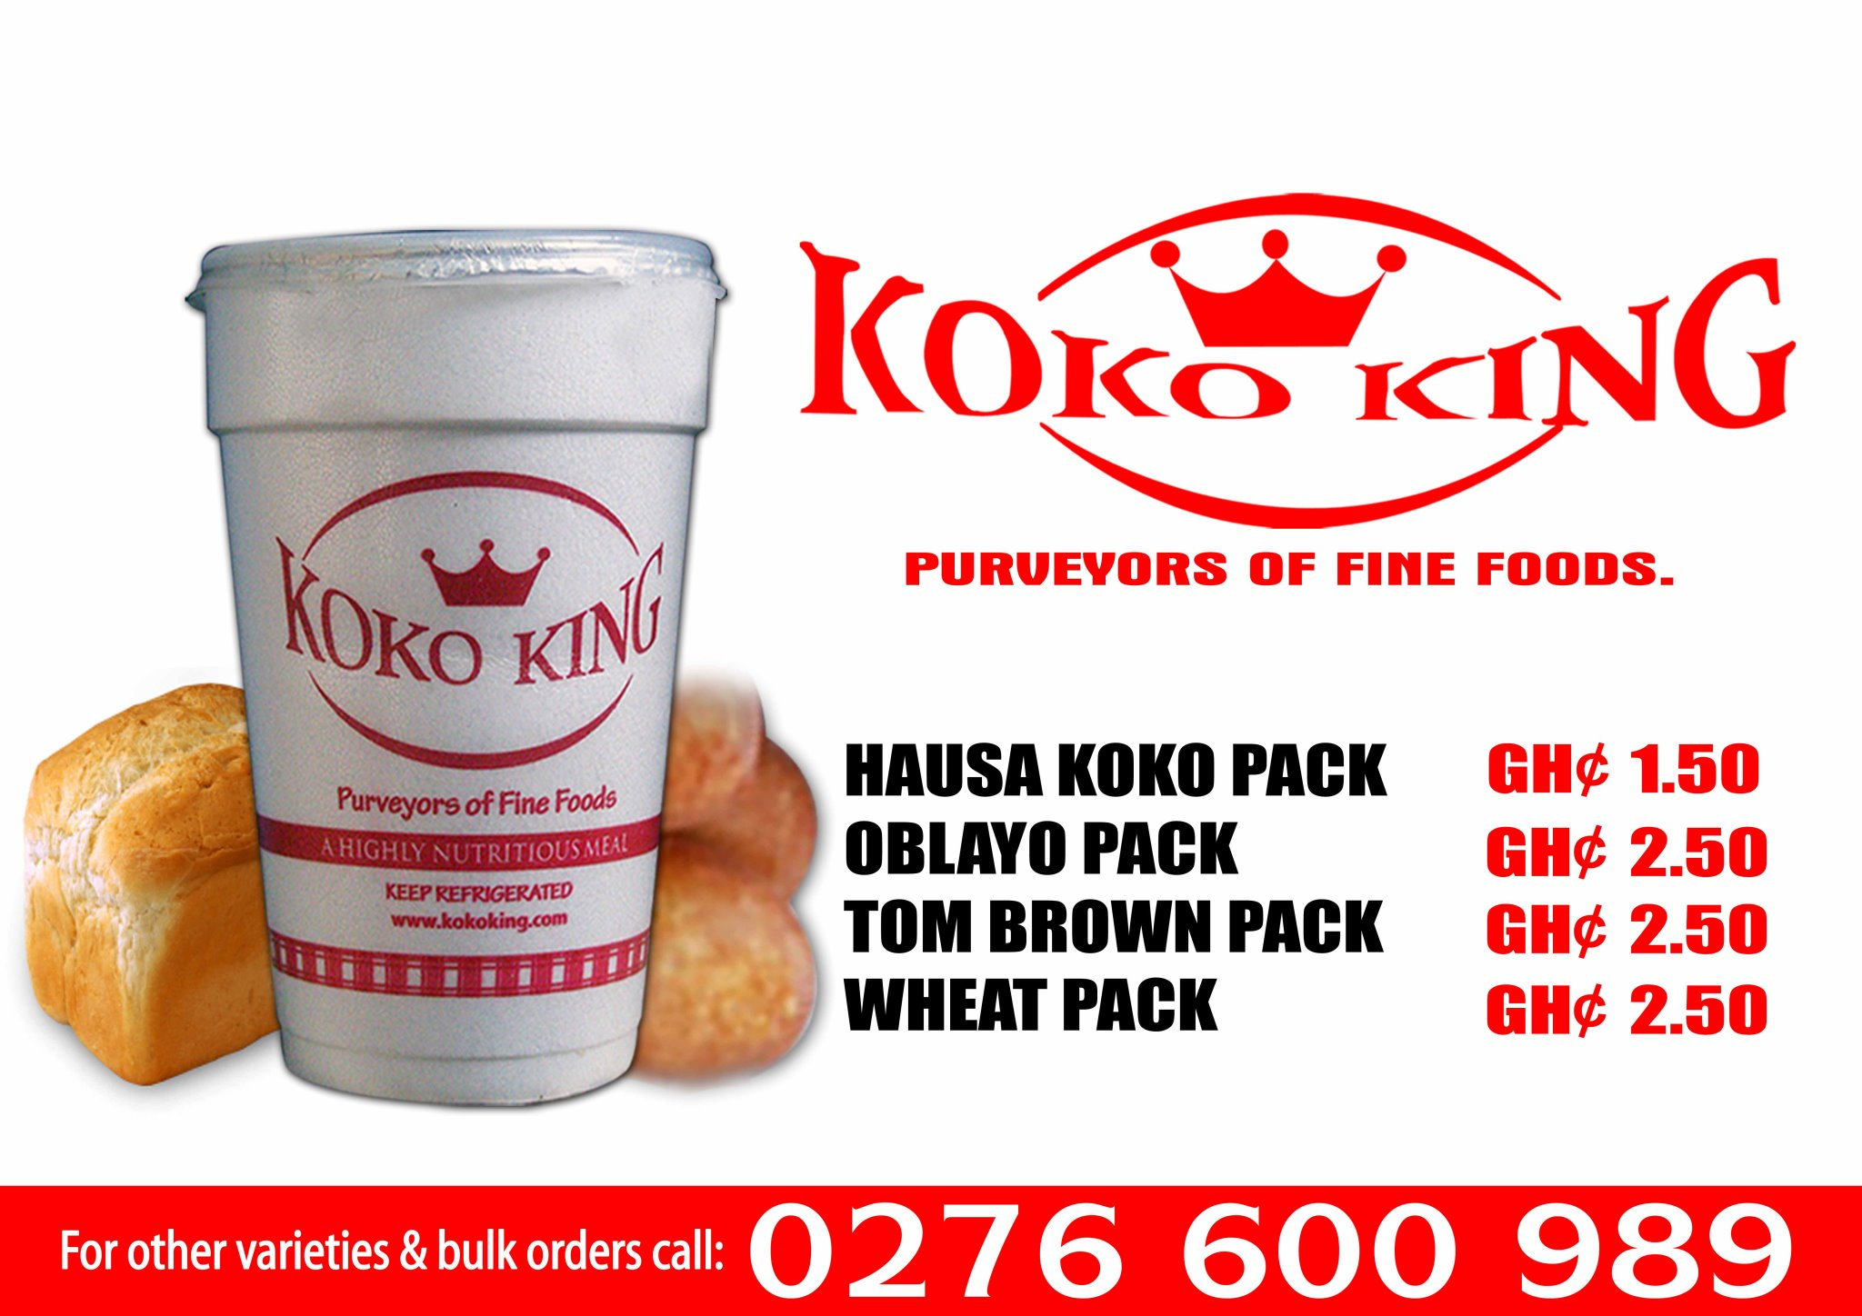

Slide 7
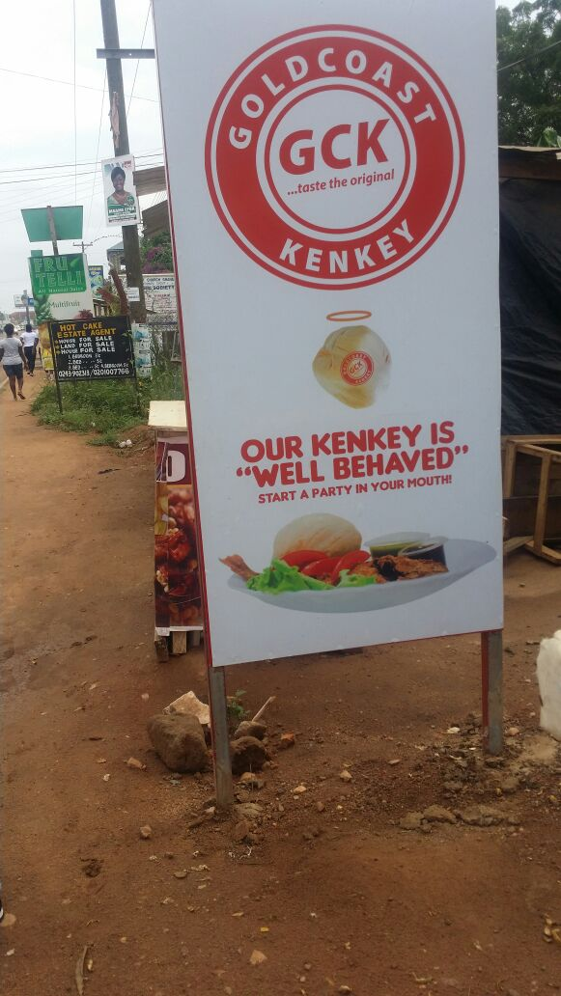

Slide 8
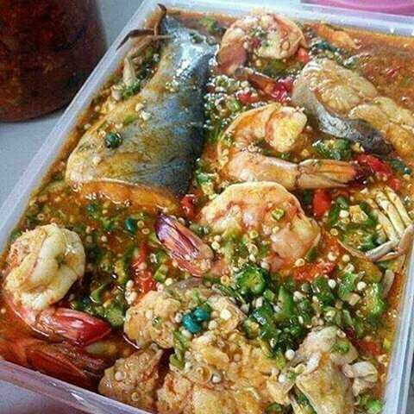

Slide 9
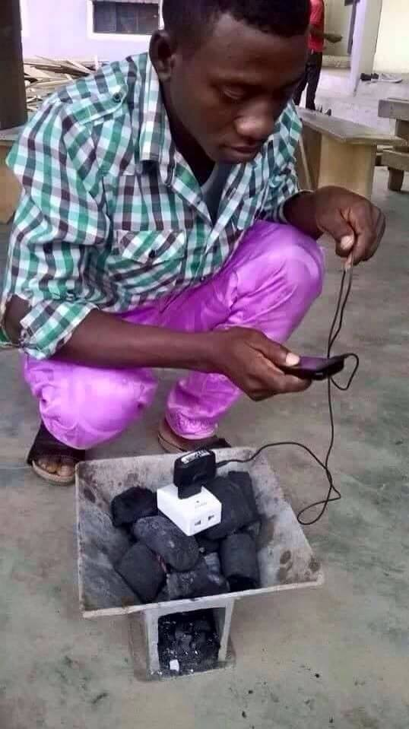

Slide 10
CREATIVITY, INNOVATION, INVENTION AND ENTREPRENEURSHIP

Slide 11
"It's easy to come up with new ideas; the hard part is letting go of what worked for you two years ago, but will soon be out of date." — Roger von Oech
Being UNIQUE has no value in itself, unless it gives the customer something of value.

Slide 12
Creativity is not a talent.
Creativity is a drive
Telling someone that we are going to have a creative process implies nothing more than: ”We are going to spend sometime coming up with something new” But, it should be:
”We are going to come up with some shit that really works.”

Slide 13
Definition
Creativity - is “the ability to bring something new into existence.
This definition emphasizes the “ability”, not the “activity”, of bringing something new into existence.
"To be creative you have to contribute something different from what you've done before. Your results need not be original to the world; few results truly meet that criterion. In fact, most results are built on the work of others."

Slide 14
Creativity
Creativity (or "creativeness") is a mental process involving the generation of new ideas or concepts, or new associations between existing ideas or concepts.
Creativity initiates a product, service or process that is useful, correct, appropriate and valuable.
“Creative thinking is not a talent, it is a skill that can be learnt. It empowers people by adding strength to their natural abilities which improves teamwork, productivity and where appropriate profits.”
Attributes of creative people; curiosity, independence of judgment, flexibility, originality and tolerance for ambiguity.

Slide 15
Creativity (contd)
To ask the question, what is creativity? It is better to ask where is creativity.
Creativity occurs at the intersection of three forces
The individual, with his or her intelligence, experience and dispositions
The domain of knowledge within which the individual has chosen to work , e.g. arts, science , business, etc.
The field or social context within which the merits of the work or product are evaluated or judged by critics, experts, organization or market.

Slide 16
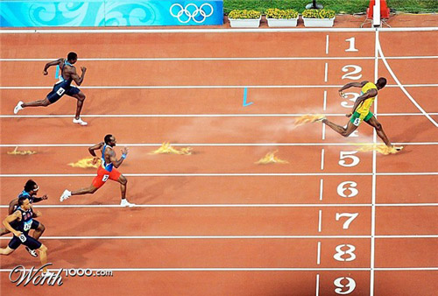

Slide 17
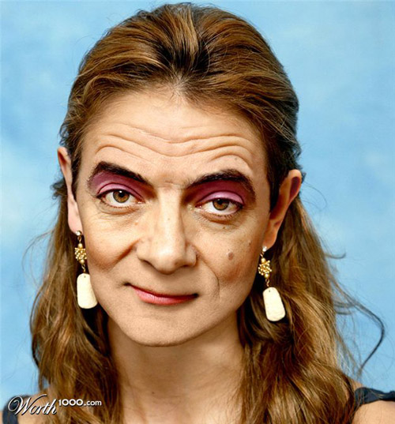

Slide 18
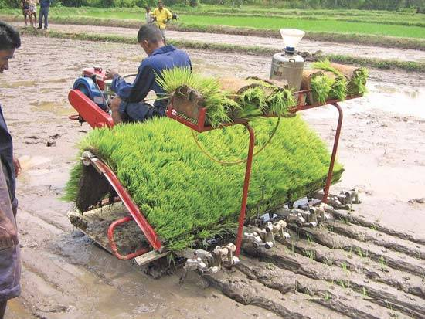

Slide 19
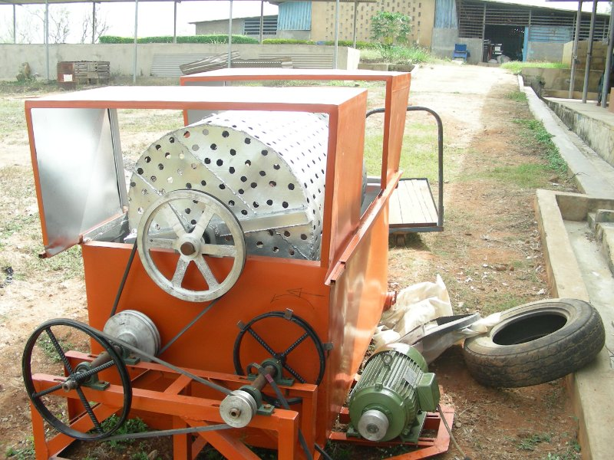

Slide 20
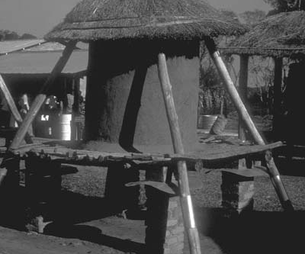
Grain storage silo in Malawi

Slide 21
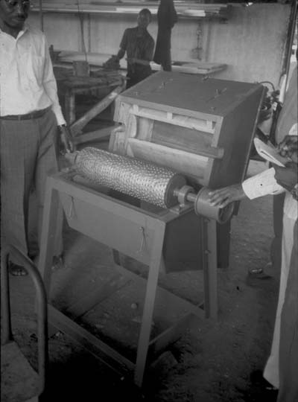
Cassava grater

Slide 22
Types of creative behavior
Three types of creative behavior
Creation; act of pure invention, that is making something out of nothing
Synthesis; creative act of joining two previously unrelated things, e.g bringing together the telephone and the computer
Modification; this occurs when a thing or process is improved or gains new application e.g. a change in design etc.

Slide 23
Methods of Generating Business Ideas/Techniques for Improving the Creative Process
Brainstorming
A creativity technique used by groups to generate a large number of ideas for solving a problem.
Some basic rules:
All members must contribute
No criticism
All ideas are captured

Slide 24
Methods of Generating Business Ideas/Techniques for Improving the Creative Process
Brainstorming – Some basic rules:
There should be a facilitator who writes ideas in brief.
No repetition of ideas
No idea is discarded – all ideas are written down

Slide 25
Methods of Generating Business Ideas/Techniques for Improving the Creative Process
Focus Group Discussion
It involves an open and in-depth discussion of ideas led by a facilitator.
The group could have between 8 and 14 participants

Slide 26
Methods of Generating Business Ideas/Techniques for Improving the Creative Process
Mind Mapping
It is diagram that is developed to show how ideas, words, tasks, activities, objects are linked.
It is used in generating ideas, analysing a problem, classifying objects, or stimulating thinking about somthing.

Slide 27
Creativity Enhancers
Elevating creativity importance throughout the organizations
Offering tangible rewards to those generating ideas
Protecting people who make honest mistakes and are willing to learn from them
Investing in resources that help employees to sharpen their creative skills
Listening attentively in order to acknowledge and provide early support to ideas

Slide 28
Creativity Detractors
Not attempting to hire creative people
Being pessimistic, judgmental and critical
Punishing mistakes or failed ideas
Pigeonholing employees
Maintaining a stiff organizational culture with no room for different behaviors
Being inattentive, acting distant and remaining silent when employees want to discuss new ideas

Slide 29
Management Style and Creativity
Encourage risk taking
Provide autonomy
Encourage productivity - “sweat equity”
Supportive supervision, climate, and work group
Participative leadership

Slide 30
Innovation
Innovation - is the process of doing new things.
Innovation, therefore, is the transformation of creative ideas into useful applications, but creativity is a prerequisite to innovation.
It is important to recognize that innovation implies action, not just conceiving new ideas. When people have passed through the illumination and verification stages of creativity, they may have become inventors, but they are not yet innovators.

Slide 31
The difference between invention and innovation is:
Invention - is the creation of new products, processes, and technologies not previously known to exist.
Innovation - is the transformation of creative ideas into useful applications by combining resources in new or unusual ways to provide value to society for or improved products, technology, or services.

Slide 32
Types of innovation
In business and economics, innovation is often divided into five types:
Product innovation, which involves the introduction of a new good or service that is substantially improved. This might include improvements in functional characteristics, technical abilities, ease of use, or any other dimension.
Process innovation involves the implementation of a new or significantly improved production or delivery method.
Marketing innovation is the development of new marketing methods with improvement in product design or packaging, product promotion or pricing.
Organizational innovation (also referred to as social innovation) involves the creation of new organizations, business practices, ways of running organizations or new organizational behavior.
Business Model innovation involves changing the way business is done in terms of capturing value e.g. Compaq vs. Dell.
Innovative Thinking: Six Simple Secrets by Padi Selwyn, M.A.

Slide 33
Richard Turere
Richard Turere a 13 year old Kenyan Boy has become a hero after inventing a method of saving cows from being eaten up by lions .
Turere who grew up at a home near Nairobi National Park ,tried out many things to save their livestock from lions from the age of 11 ,until he discovered that lions fear lights, giving birth to his current ”Lion Lights” system” .

Slide 34
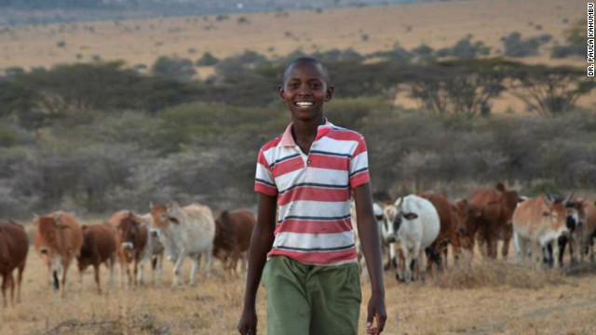
richard-turere-lion-lights

Slide 35
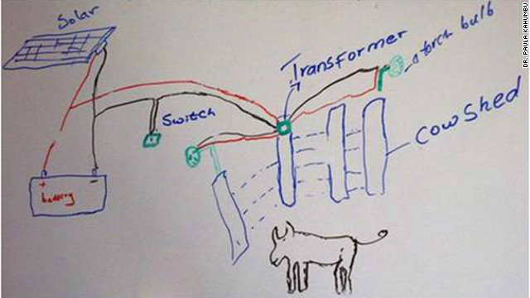

Slide 36


Slide 37
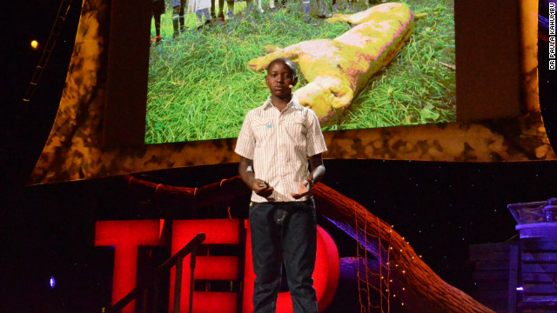

Slide 38
